Slide 1
Improved ad dollar efficiency through analytical analysis best braces, USA July 2024

Slide 2
Outline
Problem Statement
Approach
Results
Next Steps
Discussion/Questions

Slide 3
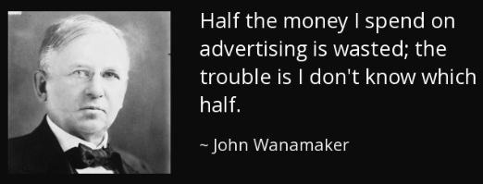
Problem Statement
Our top three products (Knee Braces, Ankle Braces, and Shoulder Braces) account for 75% of our ad spend
Advertising not targeted at the right audience through the right channels is wasted money

Slide 4

Problem Statement
Different age groups can be reached through drastically different platforms (TV, radio, social media, etc)
Through statistical analysis, we can determine which channels to use to maximize the efficiency for our key products

Slide 5
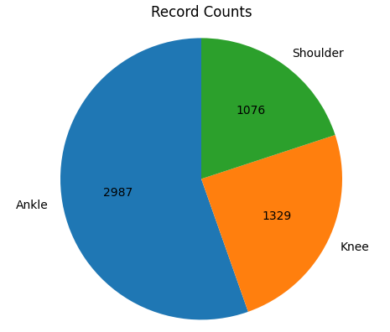
Approach: Data
We will use the 2023 U.S. Consumer Product Safety Commission dataset
Includes emergency room visits from over 100 hospitals
Specifically, we will look at sprain/strain injuries to the knee, ankle, or shoulder for men aged 15-65 (our target demographic)

Slide 6
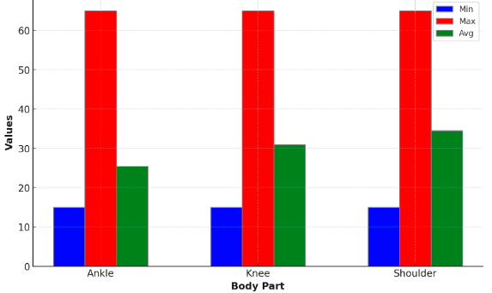
Approach: Analysis
The data was broken
out by body part

Slide 7
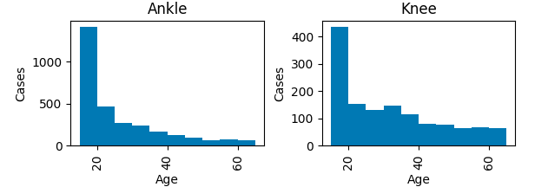
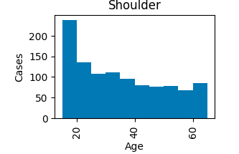
Approach: Analysis
Then the ages within those groups were compared statistically

Slide 8



Approach: Analysis
Normality testing, Kruskal-Wallis, and Dunn’s testing were all executed using python
Bootstrap sampling was used to calculate medians and confidence intervals

Slide 9
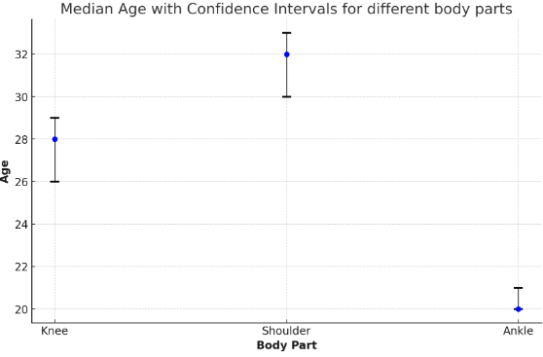
Results
A p-value of .05 / Confidence Interval of 95% was used and each body part was found to have a statistically separate affected age range

Slide 10
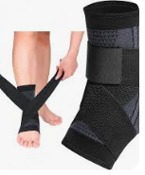
Results
Conclusion:
Knee Braces should be targeted to men in their mid to late 20s
Shoulder Braces should be targeted to men in their early to mid 30s
Ankle Braces should be targeted to men in their early 20s

Slide 11
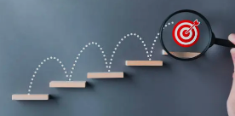
Next Steps
Complete the same exercise for females
Research other parts of the body to see if there are stand-outs which we may wish to explore (e.g. R&D into braces for new body parts)
Explore trends over multiple years of the available data. For example, if the median age for Ankle injuries is trending downwards then we may wish to explore partnerships with High School sports programs.
This dataset is rich. Given time to explore, we believe we can continue to extract useful insights.

Slide 12
Discussion/Questions

Slide 13
Appendix
Original Project Proposal:
https://docs.google.com/document/d/1k2g4J-F4umvCZMWVh3dYZQ_-RDpdbpxI/edit?usp=drive_link
Dataset:
https://www.cpsc.gov/cgibin/NEISSQuery/Data/Archived%20Data/2023/neiss2023.xlsx
Jupyter Notebook:
https://colab.research.google.com/drive/1YLZUa1pkBMRX88fcmQ2uIEpTBkimjFQb?usp=drive_link

